Slide 1
Toxicity of reddit comments in sports and esports communities
By:Logan Pappas and Reese Pearsall
Section 05- Group 11

Slide 2
Background and research
The focus of our study is observing comments from different reddit communities and determining if the comment is “toxic” or not and then comparing the communities to determine which groups have the most toxic communities. Our two research questions are:
Is the proportion of toxic comments for NFL online communities different compared to other professional traditional sports such as soccer, basketball, baseball, and hockey?
Is the proportion of toxic comments for traditional sports online communities different compared to esport online communities?
- What is an esport?
This study is interesting because we are not taking a direct survey of people but instead we are taking a sample of comments from the internet and using those to determine our results. This study is interesting to us since we are combining our major study at MSU to help determine our results.

Slide 3
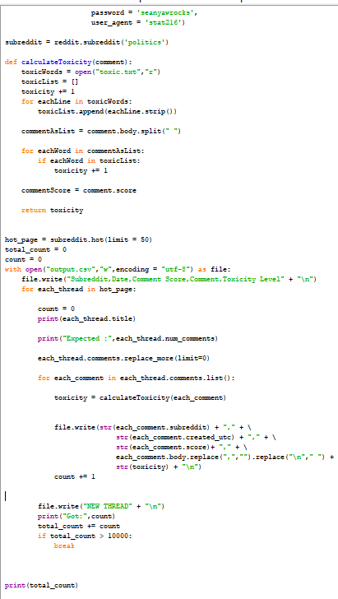

Methods
In this study, we used comments from reddit.com
Wrote code that webscraps (collects) 5000 comments** from 5 sport subreddits and 5 esport subreddits
Comments were base comments, replies, and replies to replies
Sports -> [nfl, baseball, nba, hockey, soccer]
Esport -> [leagueoflegends, GlobalOffensive, Competitiveoverwatch, DotA2, Rainbow6]
Closer look at our python script
**not completely random

Slide 4
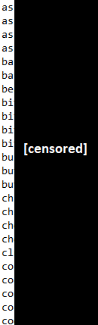
Methods
For all 50,000 comments, we went through each individual comment and marked it “toxic” or “not toxic” (using more python shenanigans)
But how do we define what is “toxic” comment is ?
Calculated the proportion of toxic comments for each subreddit/discussion board
A short look at our list of bad words
(we came up 108 swear/offensive words in total)

Slide 5
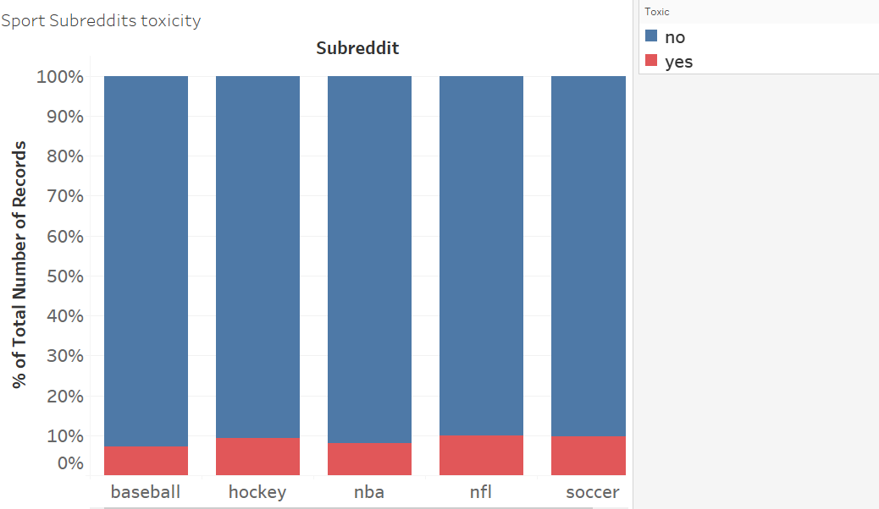
Results
Sports Subreddit Results
NFL has the highest proportion of toxic comments out of the sports communities sampled.
P-Value of 0
Non-Causal relationship

Slide 6
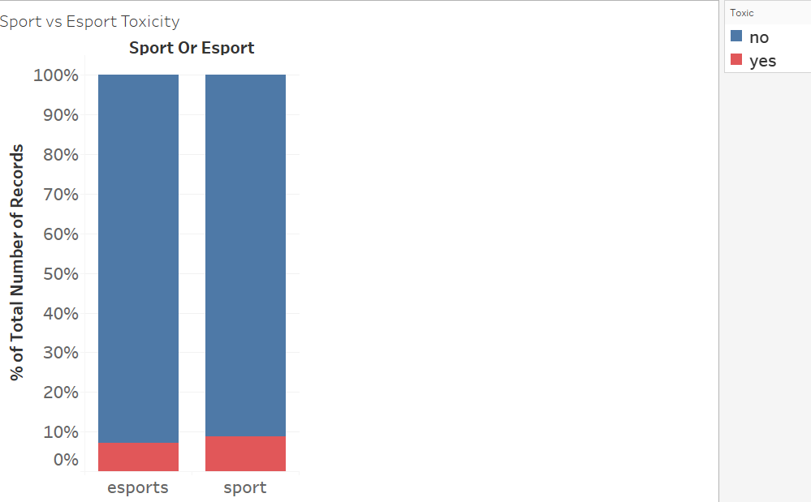
Results
Traditional Sports vs. Esports Results
Traditional sports are slightly more toxic than esports from the communities observed.
P-Value of 0
Non-Causal relationship

Slide 7
Discussion & conclusion
From our research, we also found that online traditional sports communities were slightly more toxic than online esport communities.
We can base this off of our p-value of 0 that we got from a simulation from the applets. This means that the probability of observing a difference in toxic comment proportions between esport online communities and traditional sport online communities that is greater or lower than what we observed in our study (0.01405) assuming our null hypothesis is true is 0 or 0%.
Because our p-value was incredibly small, this provides us very strong evidence that our null hypotheses of the proportion of toxic comments in traditional sport communities and esport online communities being equal is false.

Slide 8
Discussion & conclusion
Out of all of the sports communities analyzed we conclude that the NFL subreddit has the largest proportion of “Toxic” fans.
We got a p-value of 0 from this portion of our study. This means that the probability of observing a difference in toxic comment proportions between the football online community and other traditional sport online communities that is greater or lower than what we observed in our study (0.017688) assuming our null hypothesis is true is 0 or 0%.
This tells us that there is very strong evidence that our null hypothesis of the proportion of toxic comments in the football subreddit being equal to the proportion of toxic comments in similar traditional sport subreddits is false.

